Slide 1
13
Session 13 of 24
Regression: explaining and predicting a number
How much does one thing change when another changes, and how well can we predict?
Jotham Martin Wambi, KLAi Professional Learning
Session 13 Regression: explaining and predicting a number
1
Notes:
Twelve sessions in, you can load data, clean it, ask questions in SQL, draw charts and test whether a gap is more than luck. Today's question is bigger. When footfall rises, rainfall changes or a promotion runs, how many more orders does a branch get? That's regression. By the end you'll have fitted a line through the Lakeside Mart weekly data, read every number in it as a plain sentence, and said what it does not prove.

Slide 2
By the end of today
How the two hours run
Fit a linear regression and read each coefficient.
Recall and warm-up
10 min
Concepts and explanation
30 min
Check residuals.
Live demonstration
25 min
Say what the model does not prove.
Break
5 min
Guided lab
40 min
Check and wrap-up
10 min
Session 13 Regression: explaining and predicting a number
2
Notes:
You'll fit a linear regression and read each coefficient as a sentence a manager can use. You'll check the residuals, which are the misses, to see whether the line is a fair fit. And you'll say what a regression cannot prove. I fit the model twice live, first by hand in numpy and then in statsmodels, and you repeat both in the lab. Today is also Checkpoint 2, the one page analysis report, and you write your capstone question before you leave.

Slide 3
Vocabulary
Word | Plain meaning | In a spreadsheet
Regression | A method that fits a line to the data and reads how one number moves with others. | A trendline on a scatter chart
Predictor | A column used to explain or predict the outcome. | An input column
Coefficient | The number a predictor is multiplied by. It says how much the outcome changes for one step in that predictor. | The slope from SLOPE
Intercept | The model's starting level, where the line crosses the axis when every predictor is zero. | The INTERCEPT function
Least squares | Choosing the line that makes the total of the squared misses as small as possible. | The method behind a trendline
R squared | The share of the outcome's ups and downs that the model accounts for, from 0 to 1. | RSQ or the trendline box
Dummy variable | A column of 0 and 1 that stands for one category, such as one branch. | A Yes or No helper column
Session 13 Regression: explaining and predicting a number
3
Notes:
Seven words today. Regression is a trendline with a reading attached. A predictor is an input column. A coefficient is the slope for one predictor. The intercept is the starting level of the line. Least squares is the way the line is chosen. R squared is the share of the ups and downs the model accounts for. And a dummy variable is a yes or no helper column, such as is this week at Jinja. Every one of them has a cousin in a spreadsheet, and you'll meet them there too.

Slide 4
Warm-up from Session 12
1
The 95 percent interval for a lift includes zero. What do you tell the manager?
We cannot tell yet whether the lift is real. The data fits a gain, no change and a loss.
2
A p-value is tiny. Does that make the effect big?
No. The p-value says the gap is probably real. The effect size says whether it matters.
Session 13 Regression: explaining and predicting a number
4
Notes:
Two ideas from Session 12 come back today, so let's check them first.
First. The ninety five percent interval for a lift includes zero. What do you tell the manager? Have a think.
You say you can't tell yet whether the lift is real. The data fits a gain, no change and even a small loss. That answer keeps the manager from acting on luck.
Second. A p-value is tiny. Does that make the effect big? No rush.
It doesn't. A tiny p-value says the gap is probably real. The effect size tells you whether the gap is large enough to matter. Every regression coefficient comes with an interval and a size, so you'll use both ideas again in a few minutes.

Slide 5
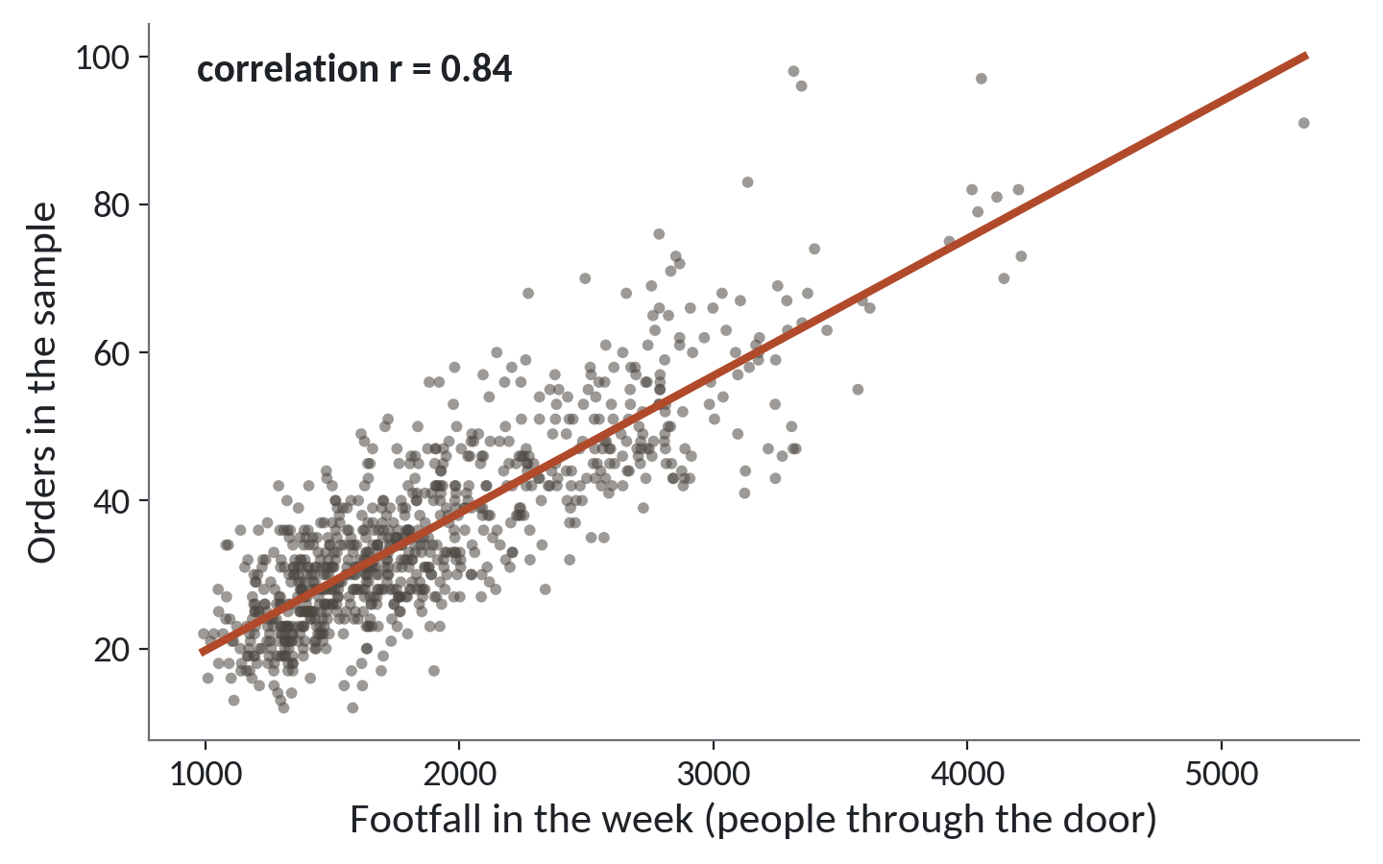
Regression draws a line through a cloud
Each dot is one branch in one week. Footfall runs across, orders run up.
The cloud. 832 branch weeks. Busy weeks sit high and right.
The line. The straight line that sits closest to all the dots.
The slope. How many more orders each extra person brings.
Session 13 Regression: explaining and predicting a number
5
Notes:
Today we answer a question you meet at work all the time. When one thing goes up, how much does another thing change?
In Excel you would draw a scatter chart and add a trendline. That trendline is regression. Regression is the method that finds the best straight line through a cloud of dots, and then reads that line as a rule.
In the picture, each dot is one Lakeside Mart branch in one week. Footfall, the count at the door, runs across the bottom. Orders run up the side. Busy weeks sit high and to the right.
The line is the average story. For each footfall it says how many orders you would usually expect. Its slope is the number we care about, because it says how many more orders each extra person brings.

Slide 6
Load the weekly file and see the link
import pandas as pd
bw = pd.read_csv('branch_weeks.csv')
print(bw.shape)
print(bw[['footfall', 'promo_on', 'orders']].head(2))
print(bw.orders.corr(bw.footfall).round(2))
1
Each row is one branch in one week.
2
Door count, promotion flag and orders.
Output
(832, 7)
footfall promo_on orders
0 2672 0 55
1 3004 0 51
0.84
3
The correlation is 0.84, strong and upward.
Session 13 Regression: explaining and predicting a number
6
Notes:
Let's look at the data before we fit any model.
We read branch_weeks.csv into a table called bw. Each row is one branch in one week. Eight branches over a hundred and four weeks give eight hundred and thirty two rows.
The next line shows three of the columns. Footfall is the door counter. The column promo_on holds a one in weeks when a promotion ran and a zero when it didn't. And orders is the number of orders that week. There's a rainfall column too, in millimetres.
The last line is the correlation you met in Session 4. It's point eight four, strong and upward. Correlation gives one number for the link. Regression goes further and tells us how much orders change.

Slide 7
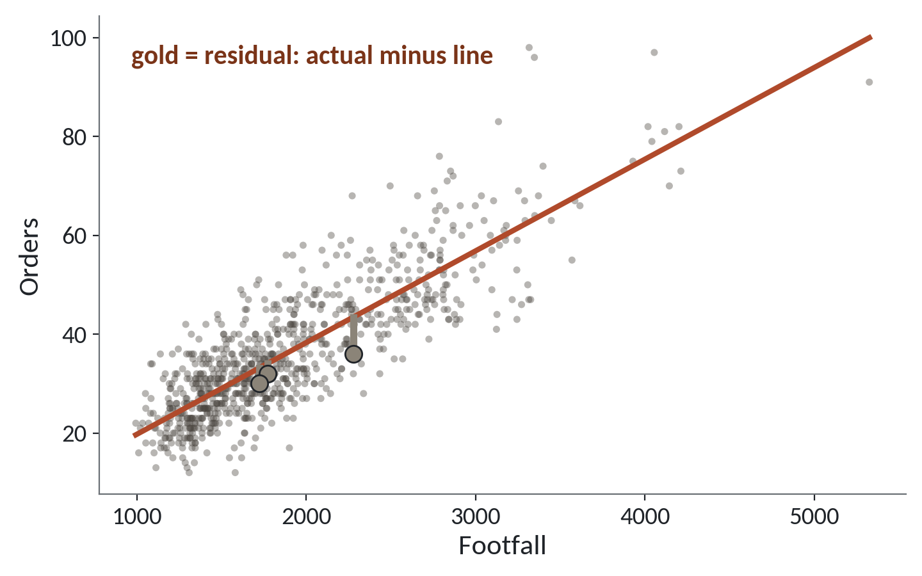
Least squares: the line with the smallest misses
1
The red line is the best straight fit.
2
Each gold bar is a residual: actual orders minus the line.
3
Least squares picks the line with the smallest total of squared misses.
Three residuals are drawn. The line is chosen so that all 832 misses, squared and added, are as small as possible.
Session 13 Regression: explaining and predicting a number
7
Notes:
How does the computer choose the line? By a picture you can hold in your head.
Try any line you like through the cloud. Every dot sits a little above or a little below it. The gold bars show three of those gaps. Each gap is called a residual. It is the actual orders minus the orders the line predicted. You met this word in Session 8 for the gap left on a reconciliation. The idea is the same. It's what is left over after the model has said its piece.
The method is called least squares. For each candidate line you take every gap, square it so that misses above and below both count, and add them up. The line with the smallest total wins.
That's all the method does. The computer does the searching, and a spreadsheet does it too, when you add a trendline.

Slide 8
The line in numbers: slope and intercept
import numpy as np
slope, intercept = np.polyfit(bw.footfall, bw.orders, 1)
print(round(slope, 4), round(intercept, 2))
print(round(slope * 1000, 1))
1
polyfit with 1 fits a straight line.
2
The slope: orders gained for each extra person.
Output
0.0185 1.23
18.5
3
Times 1,000 gives a number that is easy to say.
Session 13 Regression: explaining and predicting a number
8
Notes:
We'll write the line as two numbers. We import numpy as np, the same library we use for arithmetic on whole columns.
The function polyfit takes the x column, then the y column, then the word one, which means a straight line. It returns two numbers. The slope and the intercept.
The slope is point zero one eight five. That's orders gained for each extra person at the door. A number that small is hard to say aloud, so we multiply by a thousand. A thousand more people through the door goes with about eighteen point five more orders.
The intercept is one point two three. It's where the line meets the left edge, at zero footfall. In Sheets these two numbers come from the SLOPE and INTERCEPT functions, and you can check this on your own file.

Slide 9
Add promotion and rain: three predictors
X = np.column_stack([np.ones(len(bw)), bw.footfall, bw.promo_on, bw.rainfall_mm])
y = bw.orders.values
coef, *_ = np.linalg.lstsq(X, y, rcond=None)
miss = y - X @ coef
r2 = 1 - miss.var() / y.var()
print(coef.round(4))
print(round(r2, 3), round(miss.std(), 2))
Output
[ 2.3785 0.0188 6.7986 -0.1183]
0.795 6.07
1
A column of ones lets the line start away from zero.
2
lstsq solves least squares for all columns at once.
3
R squared is 0.795. A typical miss is about 6 orders.
Session 13 Regression: explaining and predicting a number
9
Notes:
A week has more going on than footfall. So we give the model three things to learn from. Footfall, whether a promotion ran, and rainfall. A thing we use to explain the outcome is called a predictor.
We stack the columns into one table of numbers, X. The first column is all ones. That gives the model its starting level, the intercept. The orders go in y.
Then np.linalg.lstsq does least squares for all the columns at once. It returns the coefficients in the same order as the columns. A coefficient is the number that multiplies a predictor.
Read the result. The intercept is two point three eight. Footfall is point zero one eight eight. Promotion is six point seven nine nine. Rain is minus point one one eight. And the last line gives R squared of point seven nine five, and a typical miss of about six orders. I'll explain both in a moment.

Slide 10
The same model in statsmodels
import statsmodels.formula.api as smf
formula = 'orders ~ footfall + promo_on + rainfall_mm'
model = smf.ols(formula, data=bw).fit()
print(model.summary())
1
The formula reads: orders explained by these three.
2
ols is ordinary least squares, the same method.
3
summary prints coefficients, intervals and R squared.
Session 13 Regression: explaining and predicting a number
10
Notes:
In practice most analysts use a library called statsmodels. It gives the same answer as our numpy lines and adds the extras a report needs.
The formula is the nice part. Orders, then a tilde, which you read as explained by, then the predictors joined with plus signs. It reads like a sentence. You never build the column of ones. The library adds it for you.
The function ols stands for ordinary least squares. That's the method we just ran by hand. Fit does the work.
Then summary prints a long table. The coefficients match what numpy gave us, to every decimal. The table also gives each coefficient's interval, using the idea from Session 12. Colab has statsmodels already installed, so you'll run this one in the lab. We're only learning the shape of it here.

Slide 11
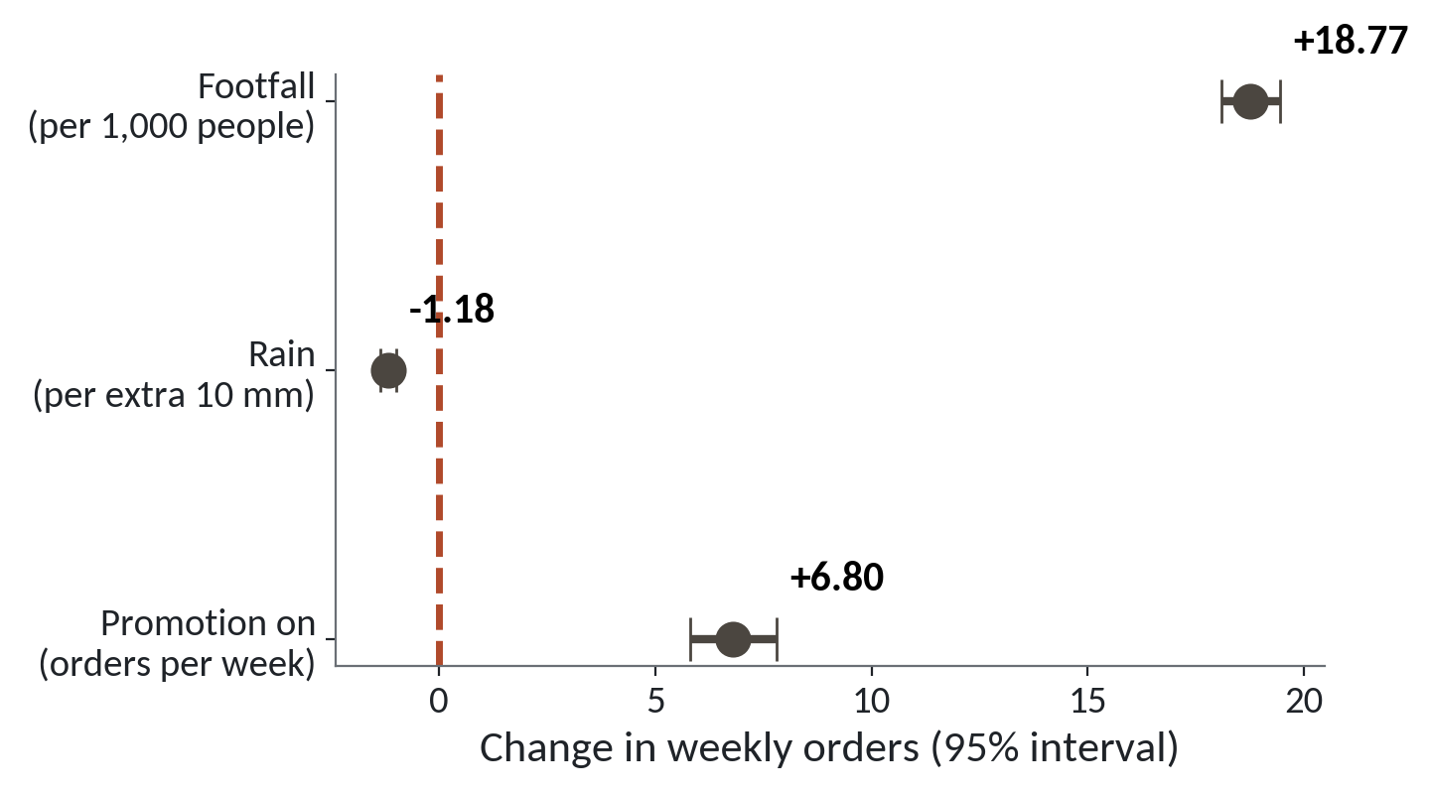
Each coefficient with its 95 percent interval
1
Footfall: about 18.8 more orders for each extra 1,000 people.
2
Promotion: about 6.8 more orders in a promotion week.
3
Rain: about 1.2 fewer orders for each extra 10 mm.
Dots are the coefficients. The bars are 95 percent intervals. None of the bars touches zero.
Session 13 Regression: explaining and predicting a number
11
Notes:
Here are the three coefficients drawn with their ninety five percent intervals. The red dashed line is zero, which means no effect.
Footfall sits far to the right. For each extra thousand people at the door, the model gives about eighteen point eight more orders in the week.
Promotion is next. In a week with a promotion, about six point eight more orders, even when footfall and rain stay the same.
Rain sits just left of zero. Each extra ten millimetres of rain goes with about one point two fewer orders. Its interval is very short, so it's a small effect, measured well.
Notice that none of the bars touches zero. You read intervals here the way you did in Session 12. If zero were inside a bar, you would say you can't tell whether that predictor matters.

Slide 12
Reading each coefficient in one plain sentence
Predictor | Coefficient | In a sentence
Footfall | 0.0188 | 1,000 more people: about 19 more orders
Promotion on | 6.80 | A promotion week: about 7 more orders
Rainfall (mm) | -0.118 | 10 mm more rain: about 1 fewer order
Intercept | 2.38 | The starting level. Not a real week
Read each sentence with the other two held the same.
Session 13 Regression: explaining and predicting a number
12
Notes:
The skill you'll use most is turning each number into a sentence a manager can use.
The pattern is always the same. When this predictor goes up by one step, the outcome changes by this much, with the others held the same. Keep that last phrase in every sentence you write. Each coefficient is read with everything else in the model kept fixed.
So footfall. A thousand more people, about nineteen more orders. Promotion. A promotion week, about seven more orders. Rain. Ten more millimetres, about one fewer order. Always choose a step that makes sense. One millimetre is too small to talk about, and a thousand people is easy to picture.
The intercept is the model's starting level. It is where the line sits when every predictor is zero, and that week never happens at Lakeside. A shop is never empty for a whole week. So we keep the intercept in the model and leave it out of the report.

Slide 13
R squared
The share of the ups and downs in the outcome that the model accounts for. It runs from 0 to 1.
In our data
In a spreadsheet
Here R squared is 0.795. The three predictors account for about 80 percent of the weekly swings in orders. The other 20 percent is left unexplained.
The RSQ function, or the R squared box on a chart trendline.
Session 13 Regression: explaining and predicting a number
13
Notes:
One more number from the summary. R squared.
In plain words, it's the share of the ups and downs in the outcome that your model accounts for. It runs from zero to one. Zero means the model explains nothing. One means it explains every week exactly.
Our model scores point seven nine five. Orders go up and down from week to week, and our three predictors account for about eighty percent of that movement. The other twenty percent is what the model can't see, such as a school event or a road closure.
In Excel you've seen this already. Add a trendline to a scatter chart, tick the box that says show R squared, and the same number appears.
R squared only says how tight the cloud sits around the line. A high value leaves open whether the model's story is right, and a low value can still give a useful prediction.

Slide 14
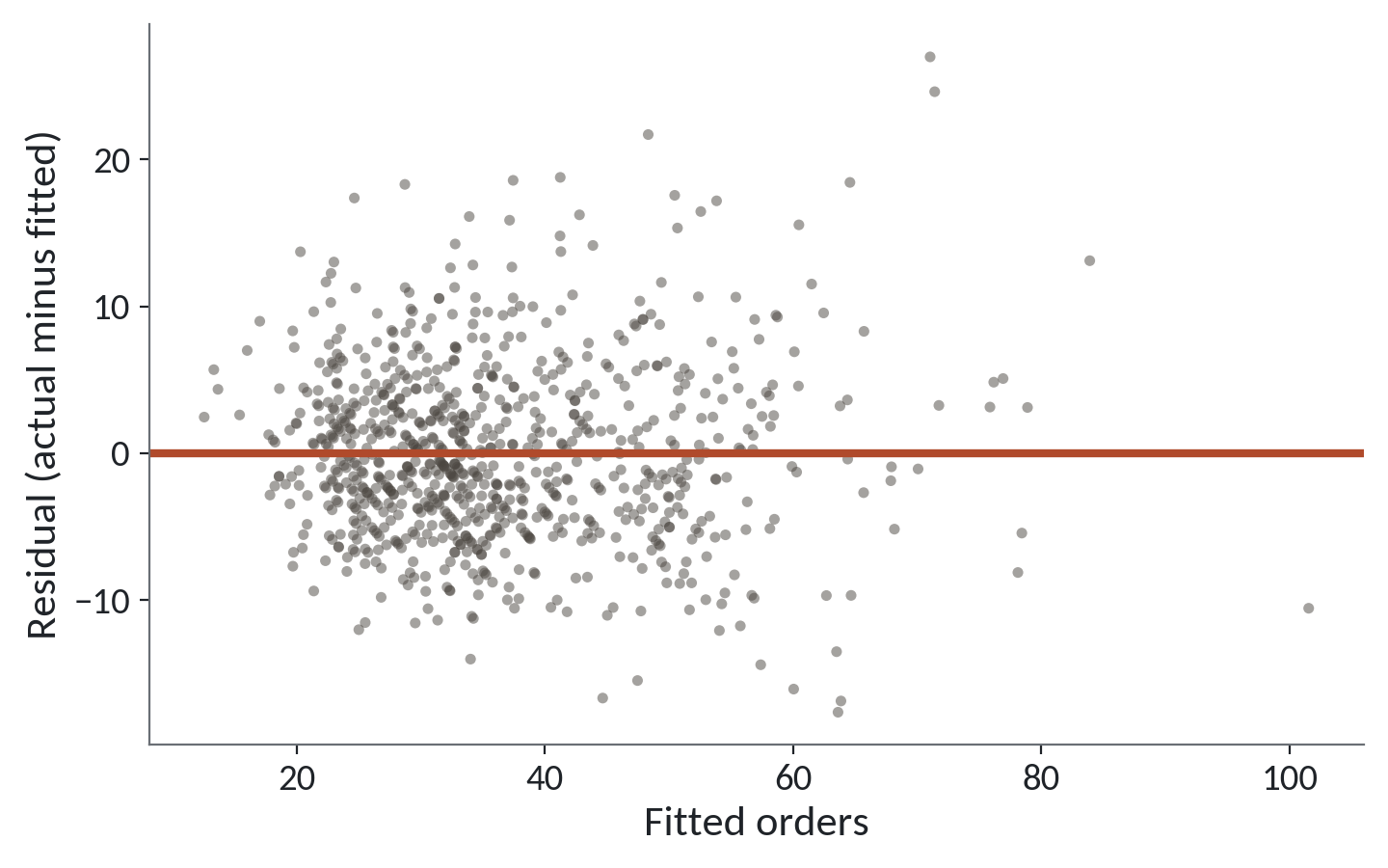
Residual check: is the cloud even?
1
Dots scatter evenly above and below zero.
2
No curve or bend. The straight line was a fair choice.
3
A few big misses at the top. Look at those weeks.
Residuals against fitted orders. A healthy plot looks like an even cloud with no shape.
Session 13 Regression: explaining and predicting a number
14
Notes:
A good analyst always checks the misses. This picture puts each week's residual against the orders the model fitted for it. Zero is the red line.
First, the dots sit evenly above and below zero. The model is not too high in some weeks and too low in others.
Second, there is no bend. If the dots curved like a smile, a straight line would be the wrong shape, and we would try something else.
Third, a few weeks sit high, with residuals near twenty five. Those are weeks when orders ran far above what the model expected. A good habit is to look up those weeks in the file and ask what happened.
The spread grows a little for busy weeks. That is common and fine here. A strong pattern would be a warning, and this one is mild.

Slide 15
Categories become 0 and 1 columns
dummies = pd.get_dummies(bw.branch_id, drop_first=True, dtype=float)
Xb = np.column_stack([X, dummies.values])
cb, *_ = np.linalg.lstsq(Xb, y, rcond=None)
r2b = 1 - (y - Xb @ cb).var() / y.var()
print(list(dummies.columns))
print(round(r2b, 3))
Output
['B02', 'B03', 'B04', 'B05', 'B06', 'B07', 'B08']
0.796
1
Seven new 0 and 1 columns. B01 is the baseline.
2
Add them to the same least squares fit.
3
R squared barely moves, 0.795 to 0.796.
Session 13 Regression: explaining and predicting a number
15
Notes:
A regression can only multiply numbers. So how do we use a category such as the branch name? We turn it into columns of zeros and ones. Each one is called a dummy variable. It answers a yes or no question, such as is this week at Jinja.
The pandas function get_dummies builds them. We drop the first one, B01, so that B01 becomes the baseline and each other branch is compared with it. That's why you see only seven names.
We add those seven columns next to our three predictors and run the same least squares. And look at R squared. It goes from point seven nine five to point seven nine six. That's tiny.
The reason is useful. Branch size already shows in the footfall. A bigger branch has more people at the door, so the branch name adds almost nothing. In statsmodels the formula for this is a plus C of branch_id at the end. The library builds the dummy columns for you.

Slide 16
Prediction and explanation
Prediction
Explanation
Question: how many orders will next week bring?
Question: what changes orders, and by how much?
A week with 2,000 people, a promotion and 20 mm of rain gives about 44 orders.
Read each coefficient with the others held the same.
Judge it on the size of the miss, about 6 orders.
Judge it on the interval, and on what the model leaves out.
The same model serves both jobs. The questions and the cautions differ.
Session 13 Regression: explaining and predicting a number
16
Notes:
There are two reasons to fit a regression, and they ask different things of you.
The first is prediction. You want next week's orders for planning staff and stock. Put in two thousand people, a promotion and twenty millimetres of rain. The model gives about forty four orders. That figure comes from the intercept plus each coefficient times its value.
You judge a prediction by its miss. Our typical miss is about six orders, so a good statement is about forty four, give or take twelve. You don't need to know why the model works to use it that way.
The second is explanation. You want to know what moves orders and by how much. You read each coefficient and its interval, with the others held the same. Here the cautions are different. You must ask what the model leaves out.
So the same model serves both jobs, and the next slides show why explanation needs more care.

Slide 17
Rain and footfall: do they move together?
print(bw.footfall.corr(bw.rainfall_mm).round(3))
Xr = np.column_stack([np.ones(len(bw)), bw.rainfall_mm])
rain_only, *_ = np.linalg.lstsq(Xr, y, rcond=None)
print(rain_only.round(4))
print(coef.round(4)[3])
1
Footfall and rain have almost no link here.
2
Rain alone: minus 0.1249 orders for each mm.
Output
-0.004
[39.5564 -0.1249]
-0.1183
3
Rain beside the other two: minus 0.1183. Hardly changed.
Session 13 Regression: explaining and predicting a number
17
Notes:
Rain keeps shoppers at home, so you'd expect wet weeks to have fewer people at the door. If that were so, rain and footfall would be linked, and each would carry part of the other's effect. That's the idea of a confounder from Session 4. So we check.
The first line gives the correlation between footfall and rain. It is minus point zero zero four. Essentially none. In this file the door counter doesn't move with the weather.
Second, we fit orders on rain alone. The coefficient is minus point one two four nine. Third, we print the rain coefficient from the full model, minus point one one eight three.
They are close. When predictors don't overlap, adding others barely changes a coefficient. In a messier shop, where weather and footfall moved together, that number would shift a lot, and that shift is your warning that the predictors share the credit.

Slide 18
A coefficient read as a cause
What it looks like
Why it goes wrong
The fix
You report that every extra 10 mm of rain costs the branch 1.2 orders. The model ran with no error, the interval is short, and the sentence sounds firm.
Regression shows how the data moves together. It cannot show what would happen if you changed one thing. Something left out, such as pay day or school term, can move rain weeks and order counts together. And weeks with promotions may not have been picked by chance.
Say goes with or linked to. Name what the model leaves out. Test a real cause with an experiment, as in Session 12.
Session 13 Regression: explaining and predicting a number
18
Notes:
Today's trap is another one with no error message.
You report that each extra ten millimetres of rain costs the branch one point two orders. The model ran. The interval is short. The sentence sounds firm, and a manager may plan around it.
The problem is what a regression can see. It sees weeks in which rain and orders moved together. It can't see what would happen if you changed one and held everything else still. Something it left out, such as pay day or the school term, could move rain weeks and order counts together. And the weeks with promotions weren't picked by a coin toss, so the promotion coefficient may carry the effect of whatever made managers choose those weeks.
The fix is in your wording. Say the model links ten more millimetres to about one fewer order. Name what the model leaves out. And when you need to know the cause, run an experiment, like the offer test from last session.

Slide 19
Why sales are noisier than orders
for target in ['orders', 'sales_ugx']:
t = bw[target].values
c, *_ = np.linalg.lstsq(X, t, rcond=None)
print(target, round(1 - (t - X @ c).var() / t.var(), 3))
print(bw.sales_ugx.max(), int(bw.sales_ugx.median()))
1
Same three predictors, two different targets.
Output
2
Orders: R squared 0.795. Sales: only 0.357.
orders 0.795
sales_ugx 0.357
7236315 1478305
3
The biggest week of sales is nearly five times the median.
Session 13 Regression: explaining and predicting a number
19
Notes:
The lab models weekly orders. Let me show you why weekly sales would be a poorer target.
The loop fits the same three predictors to two different targets. First the number of orders. Then the value of those orders in shillings.
The model explains about eighty percent of the movement in orders, but only about thirty six percent of the movement in sales. The sales target is much noisier.
The reason is the shape of baskets. Remember the histogram from Session 3. Most baskets are small, and a few are very large. One basket of three million shillings adds one to the order count, but it adds three million to the sales for that week. Footfall can't predict who walks in with such a basket.
The last line shows the effect. The best week of sales is over seven million shillings, nearly five times the median week. When the target is dominated by a few big values, pick a steadier target, or report the median.

Slide 20
Checkpoint 2 and your capstone question
Today you hand in a one page analysis report and write your capstone question.
The report
One question, one model, one sentence per coefficient, R squared, one limit.
The capstone question
One sentence that names what you want to explain or predict.
Your dataset
You choose it in Session 14: Lakeside Mart, Nile loans, District Clinics or feedback.
Session 13 Regression: explaining and predicting a number
20
Notes:
Two things happen today besides the lab. This is Checkpoint 2.
First, the report. You write one page about the weekly orders model. It has your question, your model, one plain sentence for each coefficient, R squared in words, and one limit, such as what the model leaves out. A manager should be able to read it in two minutes.
Second, you write your capstone question. The capstone is the project you build toward in Sessions 19 to 23 and present in Session 24, so today's job is to shrink the idea until it fits. Write one sentence for the question, and say which column you want to explain or predict.
You choose the dataset next session, in Session 14. Your options are the Lakeside Mart tables, the Nile Microfinance loans, the District Clinics visits or the Lakeside Mart feedback. Pick the question that sounds most interesting to you, because you'll live with it for weeks.

Slide 21
Lab: model weekly orders and explain it
1
Open the Session 13 notebook and run the setup cell
Tool and time
Google Colab
40 minutes
2
Fit the line for orders on footfall
3
Fit all three predictors with least squares
You are done when
4
Read R squared and plot the residuals
Every check cell says correct, and your report has a sentence for each coefficient and one limit.
5
Predict one week; test the rain link
6
Add the branch as a category; try statsmodels
7
Compare sales with orders, then write it up
Session 13 Regression: explaining and predicting a number
21
Notes:
The first task is the quick look we took together. You load branch_weeks.csv and check the correlation between orders and footfall. Run the setup cell in the Session 13 notebook first.
After that you fit the line with polyfit, then the three predictor model with least squares, and you read R squared and the typical miss. You plot the residuals, predict one week, and test whether rain and footfall are linked. Later tasks add the branch as a category and run the same model in statsmodels, where the coefficients should agree with numpy to a few decimals. Task nine compares orders with sales.
The last task is the write-up. Give each coefficient one plain sentence, add one limit, and write your capstone question in one sentence. You have forty minutes, and I'm around when an error stops you.

Slide 22
Questions to finish
1
The footfall coefficient is 0.0188. Say it as a sentence for a manager.
A thousand more people at the door goes with about 19 more orders in the week, with promotion and rain held the same.
2
R squared is 0.795. What does that say?
The model accounts for about 80 percent of the weekly ups and downs in orders.
3
Why can the model not tell you that rain causes fewer orders?
It only sees how the numbers move together. Something it leaves out could move both.
Session 13 Regression: explaining and predicting a number
22
Notes:
Footfall first, then R squared, then a limit. Answer each in your head before I give mine.
Question one. The footfall coefficient is point zero one eight eight. Say it as a sentence for a manager. Sit with it for a second.
A thousand more people at the door goes with about nineteen more orders in the week, with promotion and rain held the same.
Question two. R squared is point seven nine five. What does that say? Think it over.
The model accounts for about eighty percent of the ups and downs in weekly orders.
Question three. Why can the model not tell you that rain causes fewer orders? Give that a moment.
It only sees how the numbers move together. Something it leaves out, such as pay day, could move both rain weeks and orders.

Slide 23
Summary
Regression draws the best straight line through a cloud. Least squares keeps the misses, the residuals, small.
Read each coefficient as a sentence with the others held the same. R squared says how much of the movement the model accounts for.
Prediction is judged by its miss. Explanation needs care: the model shows what goes with what, never what causes what.
Next session. Machine learning: the workflow
Session 13 Regression: explaining and predicting a number
23
Notes:
One. Regression draws the best straight line through a cloud of dots. Least squares keeps the misses, the residuals, as small as it can.
Two. Read each coefficient as a sentence, with the other predictors held the same. And read R squared as the share of the movement your model accounts for.
Three. A prediction is judged by the size of its miss. An explanation needs more care, because a regression shows what goes with what and cannot show what causes what.
Next session we begin machine learning. We use the Nile Microfinance loans to teach a model from examples, and we hold some loans back so we can test it fairly. That session is also where you choose your capstone dataset, so bring your one sentence question.

